Slide 1
4-4: The value of teamwork
By Barbara Oakley, PhD

Slide 2
“Broad-perspective perceptual disorder
of the right hemisphere”

Slide 3
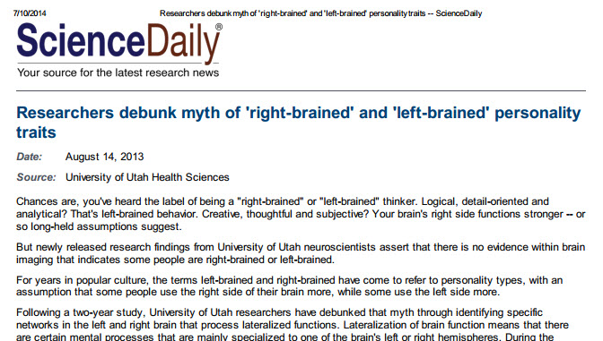

Slide 4
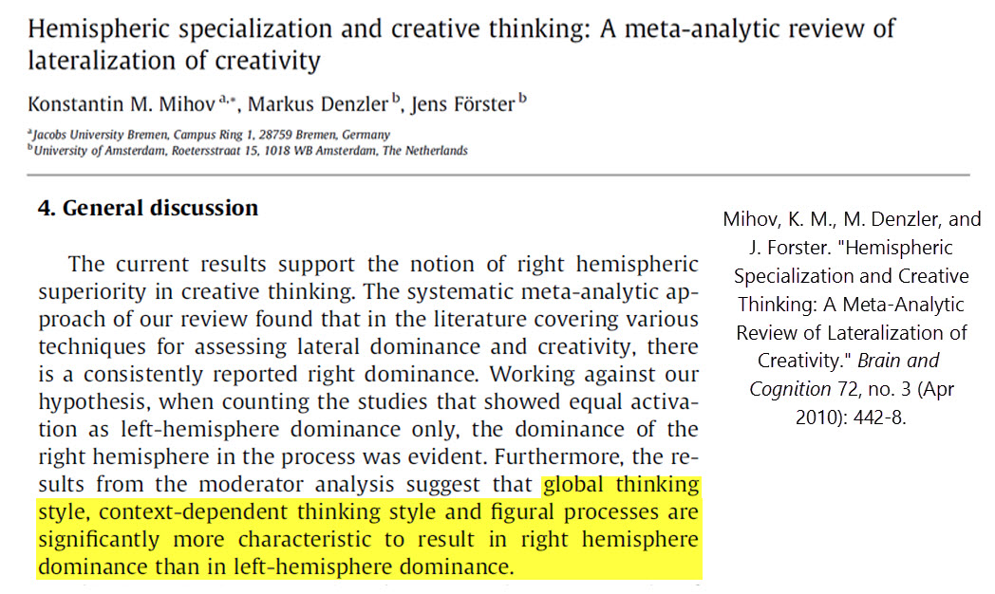

Slide 5
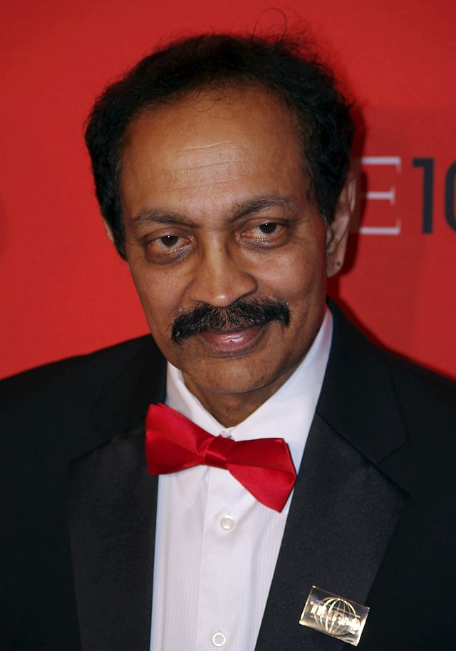
Vilayanur S. Ramachandran

Slide 6
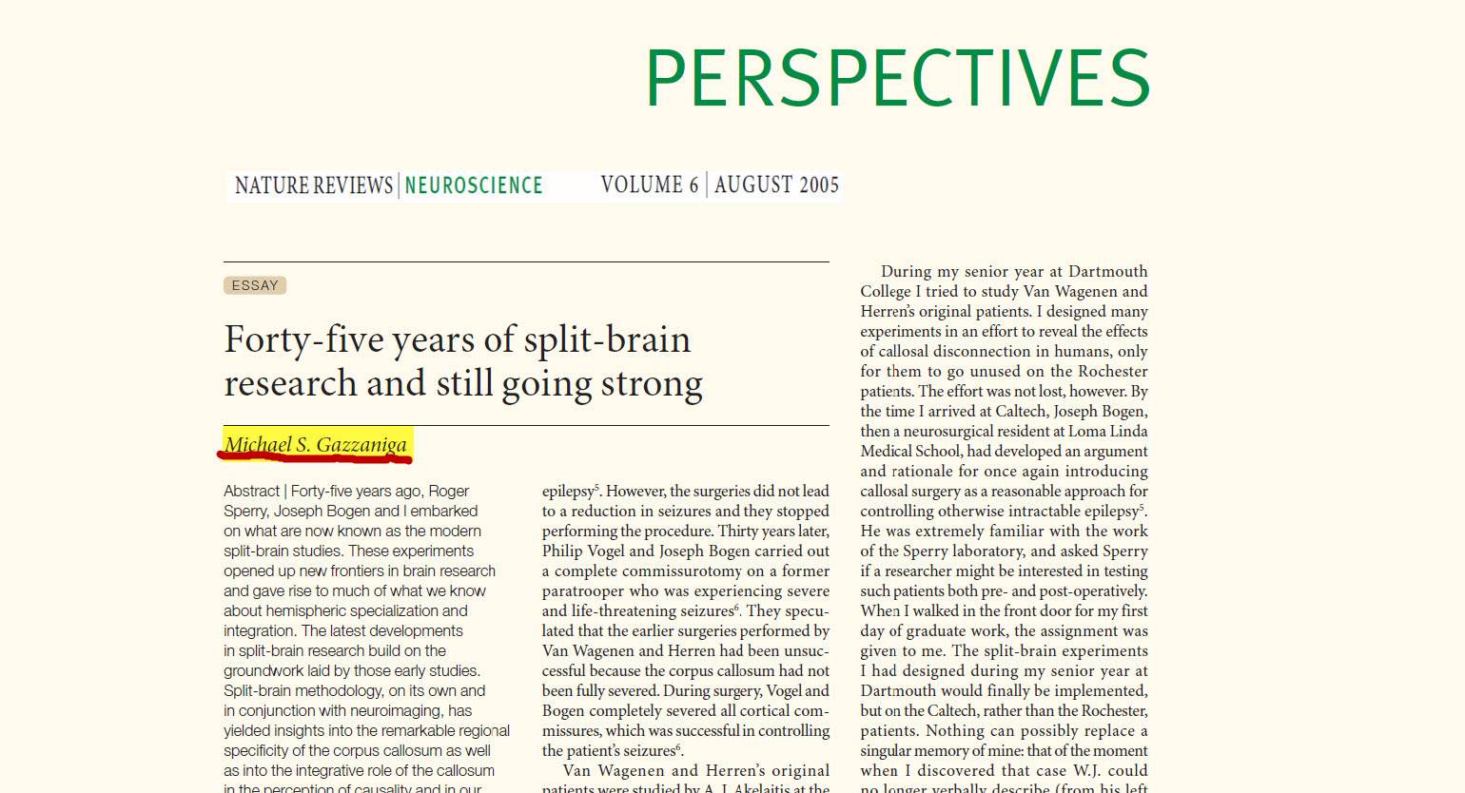

Slide 7
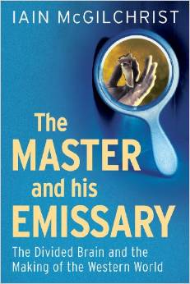


Slide 8
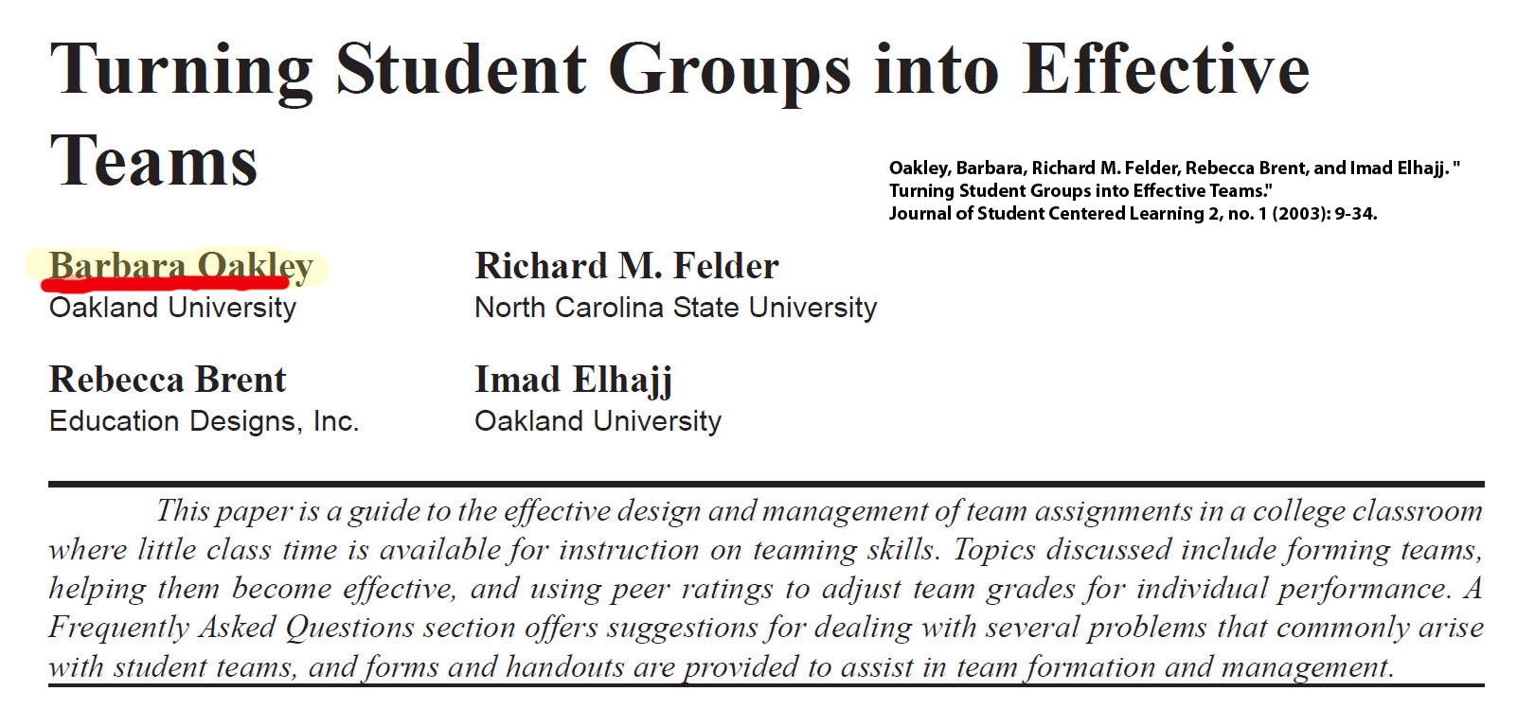

Slide 9
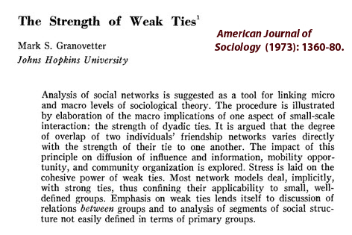

Slide 10
Illustration credits
Ischemic stroke, CT scan of the brain with an MCA infarct, by Lucien Monfils, http://en.wikipedia.org/wiki/File:MCA_Territory_Infarct.svg
University of Utah Health Care Office of Public Affairs. "Researchers Debunk Myth of 'Right-Brain' and 'Left-Brain' Personality Traits." Science Daily (2013). http://www.sciencedaily.com/releases/2013/08/130814190513.htm.
Mihov, K. M., M. Denzler, and J. Forster. "Hemispheric Specialization and Creative Thinking: A Meta-Analytic Review of Lateralization of Creativity." Brain and Cognition 72, no. 3 (Apr 2010): 442-8.
Vilayanur S Ramachandran at the 2011 Time 100 gala, by David Shankbone, http://en.wikipedia.org/wiki/Vilayanur_S._Ramachandran#mediaviewer/File:Vilayanur_S_Ramachandran_2011_Shankbone.JPG
Gazzaniga, M.S. "Forty-Five Years of Split-Brain Research and Still Going Strong." Nature Reviews Neuroscience 6, no. 8 (2005): 653-59.
Earth Eastern Hemisphere, NASA -http://en.wikipedia.org/wiki/Earth#mediaviewer/File:Earth_Eastern_Hemisphere.jpg
Cover from McGilchrist, Iain. The Master and His Emissary: The Divided Brain and the Making of the Western World. New Haven, CT: Yale University Press, 2010.
Oakley, Barbara, Richard M. Felder, Rebecca Brent, and Imad Elhajj. "Turning Student Groups into Effective Teams." Journal of Student Centered Learning 2, no. 1 (2003): 9-34.
Granovetter, Mark. "The Strength of Weak Ties: A Network Theory Revisited." Sociological Theory 1, no. 1 (1983): 201-33.

Slide 11
Relevant Readings
Bilalić, Merim, A. Kiesel, C. Pohl, M. Erb, and W. Grodd. "It Takes Two—Skilled Recognition of Objects Engages Lateral Areas in Both Hemispheres." PLoS ONE 6, no. 1 (2011): e16202.
Christman, S.D., B.R. Henning, A.L. Geers, R.E. Propper, and C.L. Niebauer. "Mixed-Handed Persons Are More Easily Persuaded and Are More Gullible: Interhemispheric Interaction and Belief Updating." Laterality 13, no. 5 (2008): 403-26.
Efron, Robert. The Decline and Fall of Hemispheric Specialization. Hillsdale, NJ: Lawrence Erlbaum Associates, 1990.
Ellis, Aleksander PJ, John R Hollenbeck, Daniel R Ilgen, Christopher OLH Porter, Bradley J West, and Henry Moon. "Team Learning: Collectively Connecting the Dots." Journal of Applied Psychology 88, no. 5 (2003): 821.
Feynman, Richard. "Surely You're Joking, Mr. Feynman". NY: W. W. Norton, 1985.
Gazzaniga, M.S. "Forty-Five Years of Split-Brain Research and Still Going Strong." Nature Reviews Neuroscience 6, no. 8 (2005): 653-59.
Granovetter, Mark. "The Strength of Weak Ties: A Network Theory Revisited." Sociological Theory 1, no. 1 (1983): 201-33.
Granovetter, Mark S. "The Strength of Weak Ties." American Journal of Sociology (1973): 1360-80.
Houdé, Olivier. "Consciousness and Unconsciousness of Logical Reasoning Errors in the Human Brain." Behavioral and Brain Sciences 25, no. 3 (2002): 341-41.
McGilchrist, Iain. The Master and His Emissary: The Divided Brain and the Making of the Western World. New Haven, CT: Yale University Press, 2010.
———. "Reciprocal Organization of the Cerebral Hemispheres." Dialogues in Cinical Neuroscience 12, no. 4 (2010): 503-15.
Mihov, K. M., M. Denzler, and J. Forster. "Hemispheric Specialization and Creative Thinking: A Meta-Analytic Review of Lateralization of Creativity." Brain and Cognition 72, no. 3 (Apr 2010): 442-8.
Nielsen, Jared A. , Brandon A. Zielinski, Michael A. Ferguson, Janet E. Lainhart, and Jeffrey S. Anderson. "An Evaluation of the Left-Brain Vs. Right-Brain Hypothesis with Resting State Functional Connectivity Magnetic Resonance Imaging." PLOS ONE 8, no. 8 (2013).
Oakley, Barbara, Richard M. Felder, Rebecca Brent, and Imad Elhajj. "Turning Student Groups into Effective Teams." Journal of Student Centered Learning 2, no. 1 (2003): 9-34.
Ramachandran, Vilayanur S. Phantoms in the Brain. NY: Harper Perennial, 1999.
Schutz, Larry E. "Broad-Perspective Perceptual Disorder of the Right Hemisphere." Neuropsychology Review 15, no. 1 (2005/03/01 2005): 11-27.
University of Utah Health Care Office of Public Affairs. "Researchers Debunk Myth of 'Right-Brain' and 'Left-Brain' Personality Traits." Science Daily (2013). http://www.sciencedaily.com/releases/2013/08/130814190513.htm.

